Slide 1

Ash Wednesday
Rend your heart and Return to God
Joel 2:1-2, 12-17; Matthew 6:1-6, 16-21

Slide 2
Ash Wednesday
Rend your heart and Return to God
In the biblical context, the “Day of the Lord" is a time when God judges evil and injustice, delivers or vindicates the faithful, establishes His rule and righteousness and so, Joel is calling His people to repentance to turn back to God and seek forgiveness before it’s too late.

Slide 3

Rend your
Heart

Slide 4

The “Day of the LORD” is God’s spiritual wake-up call! No snoozing allowed!

Slide 5
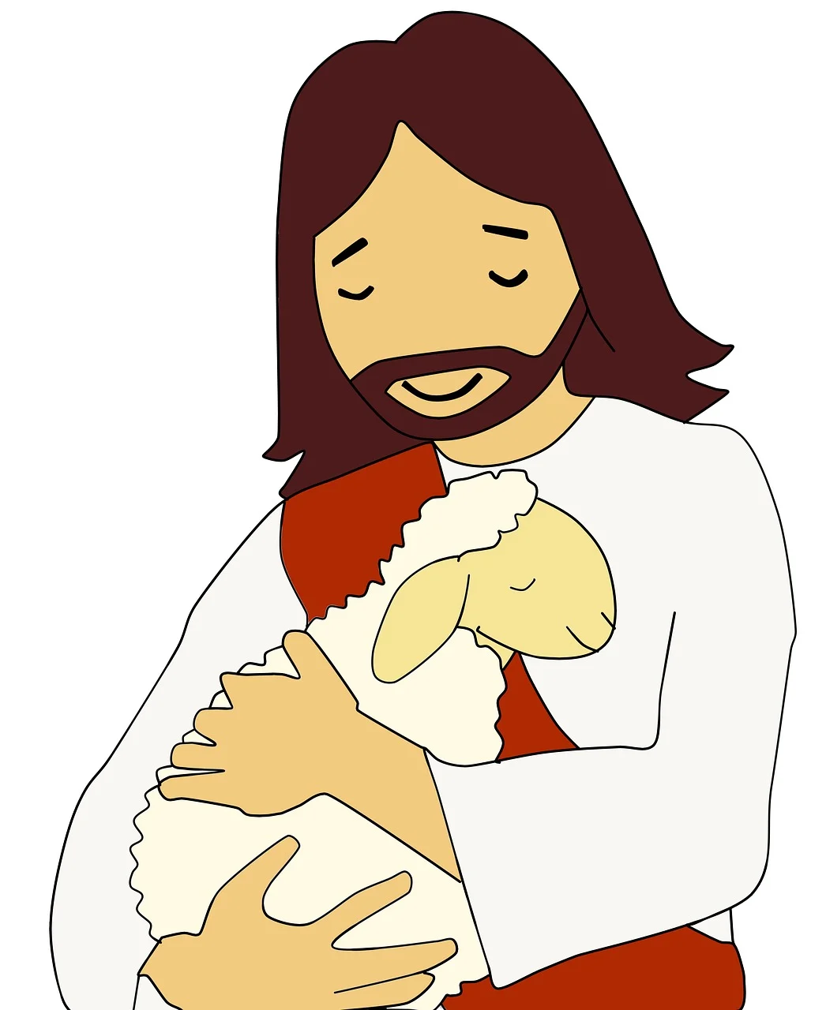
Return to
God

Slide 6

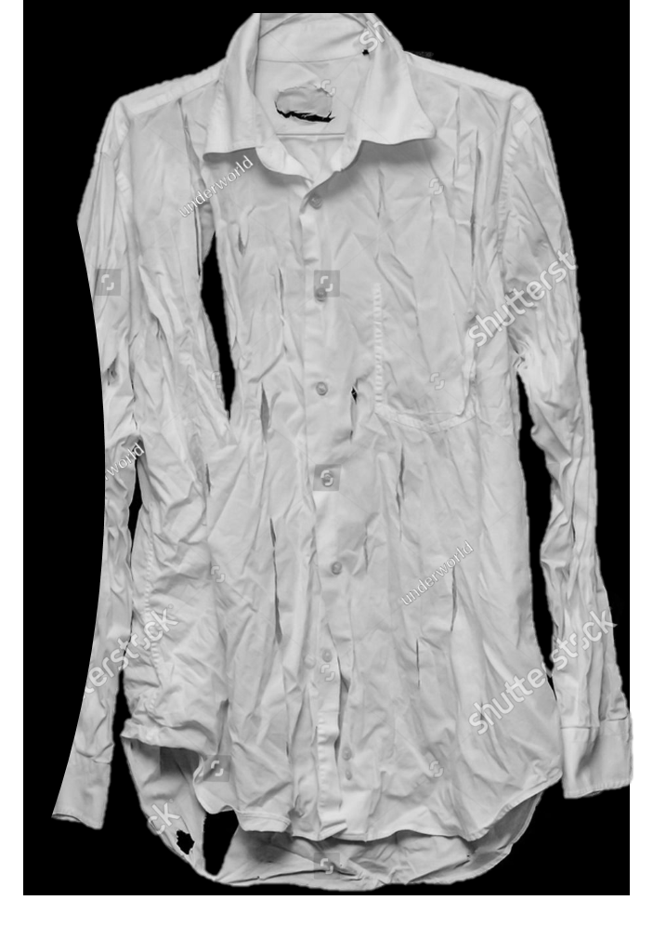
Joel 2:13, “Rend your hearts and not your garments,”
That deceptive heart is found even in our worship of God.
Matthew 15:8-9, ‘These people honour me with their lips, but their hearts are far from me. They worship me in vain; their teachings are merely human rules.’

Slide 7
2 Timothy 3:16-17, ‘All Scripture is breathed out by God and profitable for teaching, for reproof, for correction, and for training in righteousness, that the man of God may be complete, equipped for every good work.’
But it is us who must faithfully walk in God’s ways, a determined taking of ourselves in hand-getting out of bed every morning and deciding to be faithful.

Slide 8
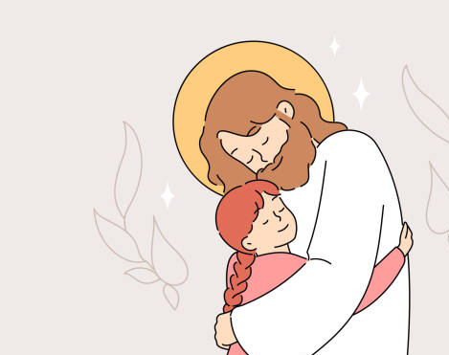
Relying on
God’s LOVE

Slide 9
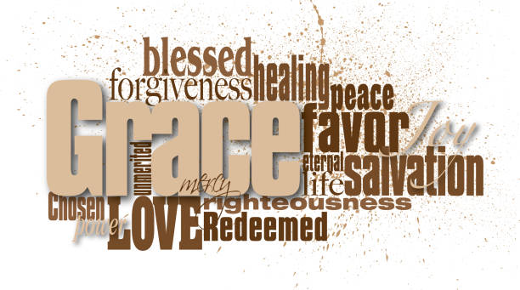
God’s graciousness in Joel 2:13 is expressed in the totally unmerited favour that is bestowed on His people. That, perhaps, is the heart of the Gospel story.
God’s graciousness in Joel 2:13 is expressed in the totally unmerited favour that is bestowed on His people. That, perhaps, is the heart of the Gospel story.

Slide 10
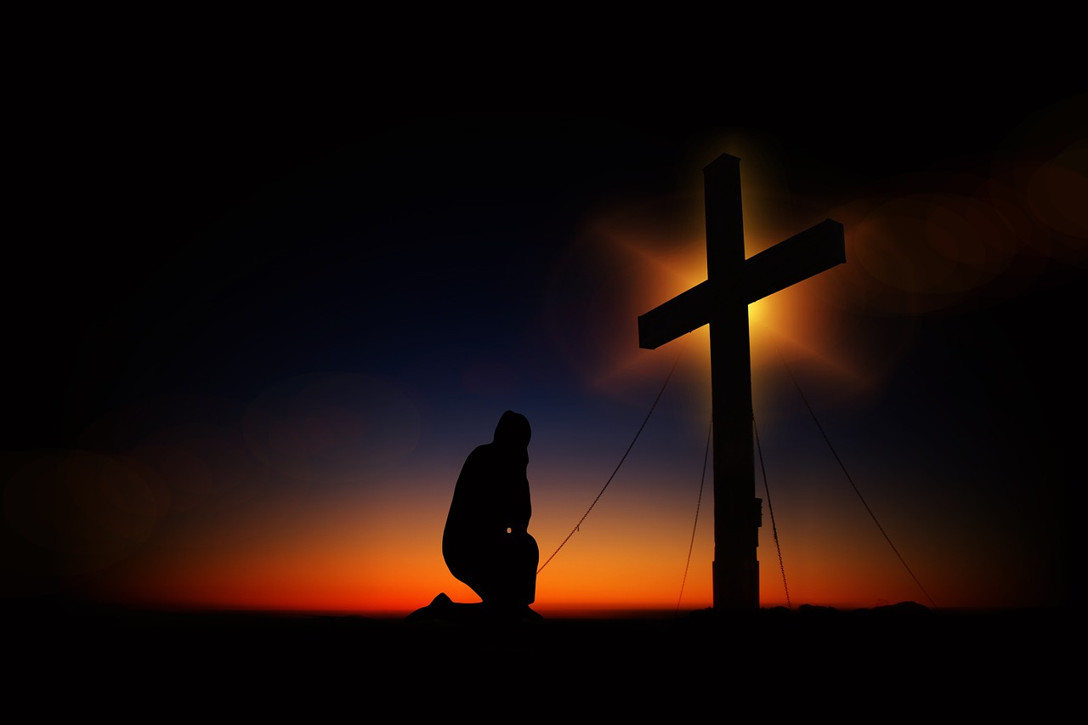
Return to God!

Slide 11


Matthew 6:17 & 18, ‘But when you fast, anoint your head and wash your face, that your fasting may not be seen by others by your Father who is in secret. And your Father who see in secret will reward you.’

Slide 12

Coming back to Joel 2:12, ‘Yet even now’ declares the Lord, ‘return to me with all your heart…rend your heart and not your garments.’ No matter how troubled you are or how far you might deem to be from God – return to Him and rely on His amazing love.

